Slide 1


Slide 2
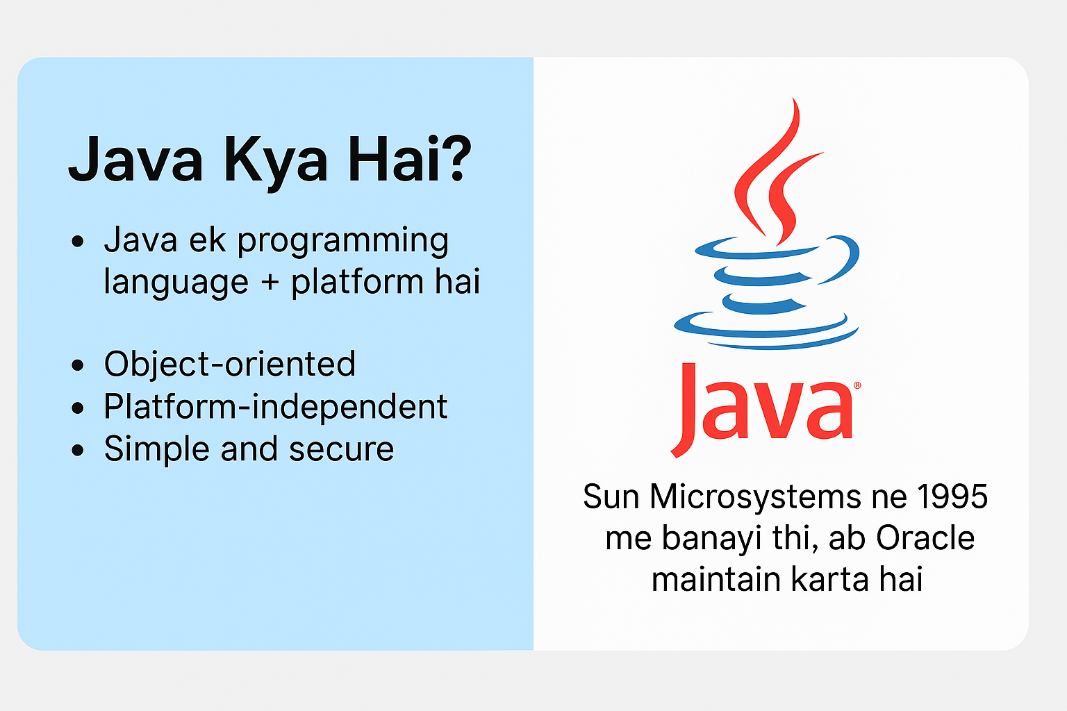
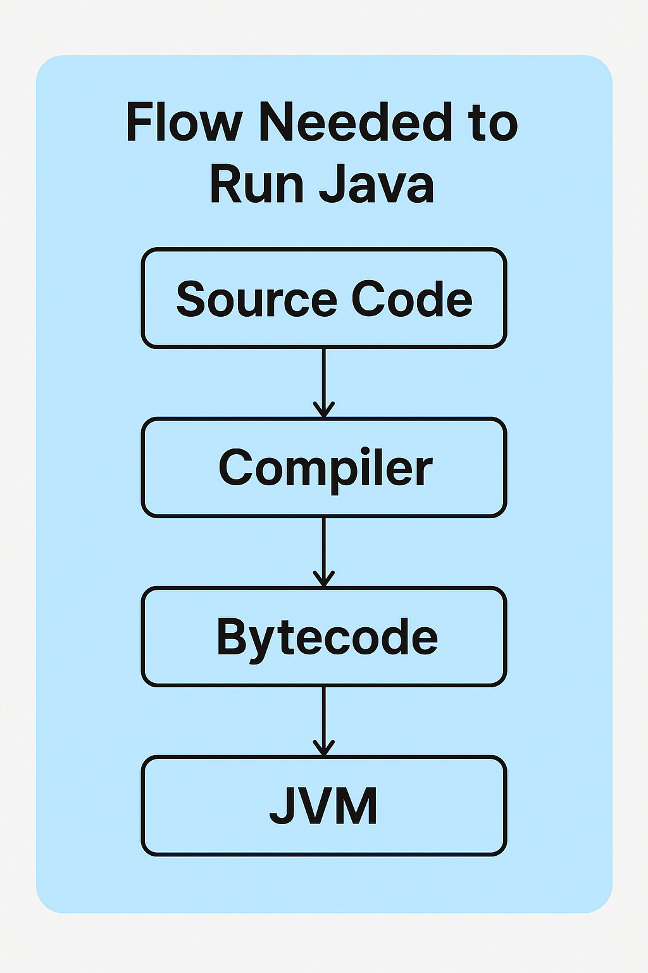

Slide 3
Java ek high-level programming language + platform hai
Developed in 1995 by Sun Microsystems
Maintained by Oracle
Used in web, mobile (Android), desktop, enterprise apps

Slide 5
Why Platform Independent?
Bytecode same hoti hai for all OS
JVM har OS ke liye alag hota hai
Isliye ek hi code multiple platforms pe run hota hai

Slide 6
Components Needed
JDK → Java Development Kit
Code likhne & compile karne ke liye
JRE → Java Runtime Environment
Java applications chalane ke liye
JVM → Java Virtual Machine
Bytecode execute karta hai

Slide 7
Java Program → Chai Banani hai
🍳 JDK → Kitchen Setup (tools + ingredients)
🔥 JRE → Gas Stove & Utensils (environment)
🥤 JVM → Cup (jo final chai serve kare)

Slide 8
https://www.oracle.com/java/technologies/javase-downloads.html

